Slide 1
Bridges / Switches

Slide 2
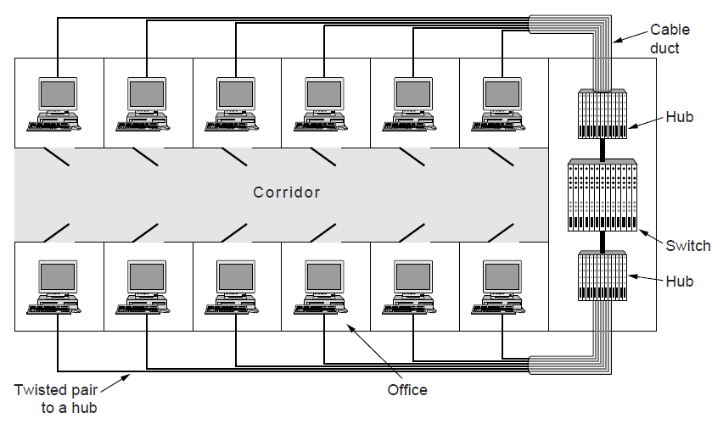
Bridges / Switches
Centralized wiring using hubs and a switch.

Slide 3
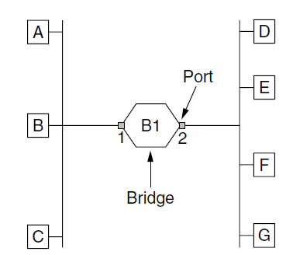
Learning Bridges
Bridge connecting two LANs
Computers, other bridges or hubs can be connected to its ports

Slide 4
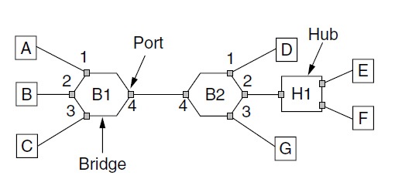
Learning Bridges
Bridges (and a hub) connecting seven point-to-point stations.

Slide 5
Backward Learning
For each input frame, how to decide what port to output it to?
Associate frame source address with input port
Frames with known destination address sent to learned port
Frames with unknown destination sent to all ports (except the input port)
Forget unused entries to allow address reuse

Slide 6
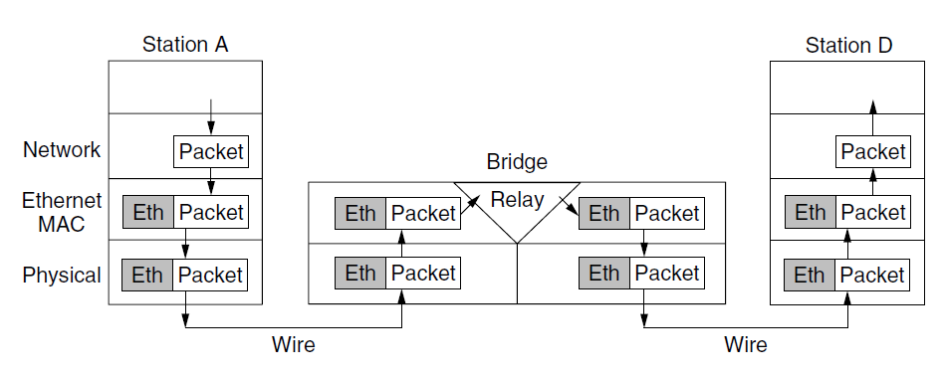
Learning Bridges
We say that “Bridges are a layer 2 device”.
They will inspect (but not modify) the L2 header.

